Slide 1

Presented By: SREE RAM BANDLA
PHASE – II
DATA CLEANING & MANIPULATION
On NETFLIX DATA

Slide 2
About me
I am Bandla Sree Ram, a recent graduate with a Bachelor of Technology in Electronics and Communication Engineering, from RSREC College of Engineering.
Why Data Science?
I chose Data Science because I love finding insights from data and solving real-world problems. It’s a field with huge growth, innovation, and career opportunities.

Slide 3
PROBLEM SUMMARY
Missing Values:
•Director column has many missing entries (not available for TV shows mostly).
•Cast and Country columns also have missing values.
•A few missing in Release_Date and Rating.
•Inconsistent Data Types:
•Release_Date stored as text instead of proper date format.
•Duration mixes “minutes” (for Movies) and “Seasons” (for TV Shows).
•Duplicates & Redundancy:
•Possible repeated directors, cast members, or categories written in different styles.
•Some entries in Type column overlap (e.g., “Dramas” vs. “International Dramas”).

Slide 4
•Unstructured Text Fields:
•Type and Description contain multi-category or long free-text, not standardized.
•Hard to analyze directly without preprocessing.
•Imbalance in Categories:
•Likely more Movies than TV Shows (needs verification).
•Some countries dominate the dataset (e.g., USA, India), while others are sparse.
•Non-Standard Ratings:
•Type and Description contain multi-category or long free-text, not standardized.
•Hard to analyze directly without preprocessing.
•Imbalance in Categories:
•Likely more Movies than TV Shows (needs verification).
•Some countries dominate the dataset (e.g., USA, India), while others are sparse.

Slide 5
Missing Values
•Director & Cast: Replace with “Not Available”.
•Country: Replace with “Unknown”.
•Release_Date: Convert to datetime, keep missing as “Not Available”.
•Rating: Replace with “Not Rated”.
•Duration: Standardize → minutes for Movies, seasons for TV Shows.

Slide 6
Duplicates & Inconsistencies
Duplicates: Checked by Title + Category → dropped any exact duplicate rows.
Release_Date: Converted to proper datetime format.
Duration: Standardized → minutes (Movies) / seasons (TV Shows).
Ratings: Unified format (e.g., TV-MA, PG, R kept consistent).
Country & Type: Normalized text (trimmed spaces, corrected casing).

Slide 7
Data Type Corrections
Importance:
Ensures accurate analysis, sorting, and filtering.
Prevents errors during visualization and calculations.
Converts text fields into meaningful numeric/date formats.Changes Made:
Release_Date: Converted from text → datetime.
Duration: Split into integer minutes (Movies) and integer seasons (TV Shows).
Show_Id, Category, Title, Director, Cast, Country, Type, Description: Kept as categorical/text.
Rating: Standardized as categorical values.

Slide 8
Bivariate Insights
Category vs. Duration:
Movies typically range between 80–120 minutes.
TV Shows mostly have 1–2 seasons, fewer with 5+ seasons.
Category vs. Rating:
Movies often rated TV-MA, PG-13, R.
TV Shows lean toward TV-MA, TV-14.
Country vs. Category:
United States & India produce the highest number of Movies.
South Korea & Japan contribute more TV Shows (esp. dramas/anime).
Release Year vs. Category:
Surge in both Movies & TV Shows after 2015, peaking around 2018–2020.
Type (Genre) vs. Category:
Dramas & Comedies dominate Movies.
International Dramas & Kids/Family dominate TV Shows.

Slide 9
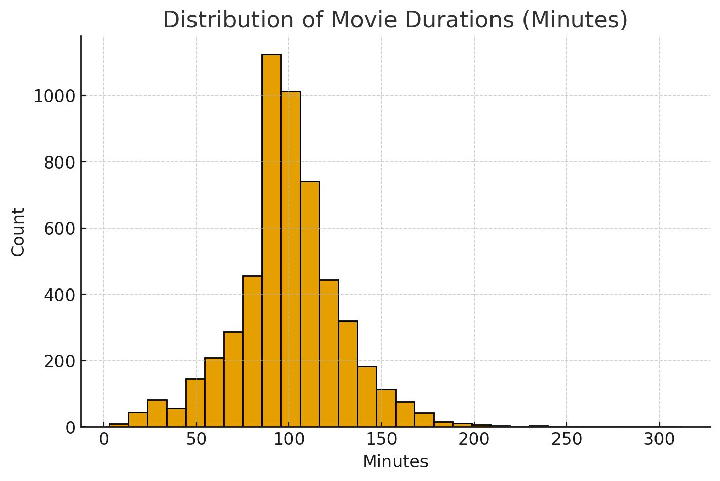
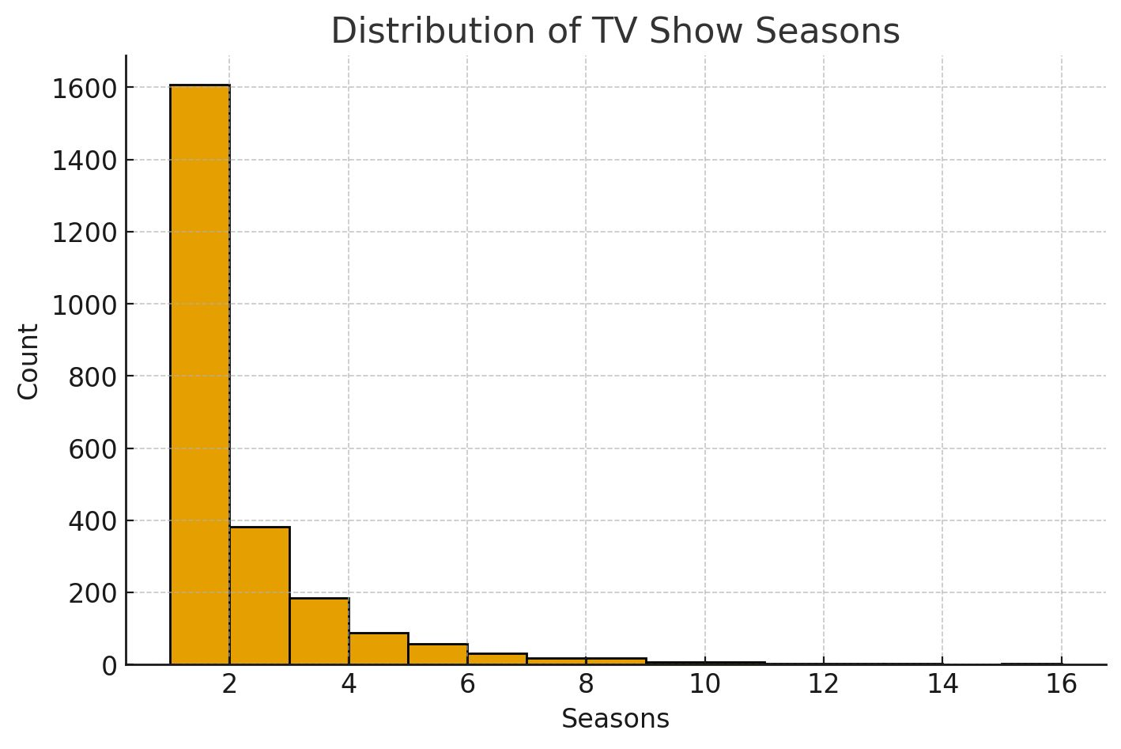
Visual Charts for Bivariate Insights
HISTOGRAM OF MOVIE DURATIONS (MINUTES)
HISTOGRAM OF TV SHOWS (SEASONS)

Slide 10
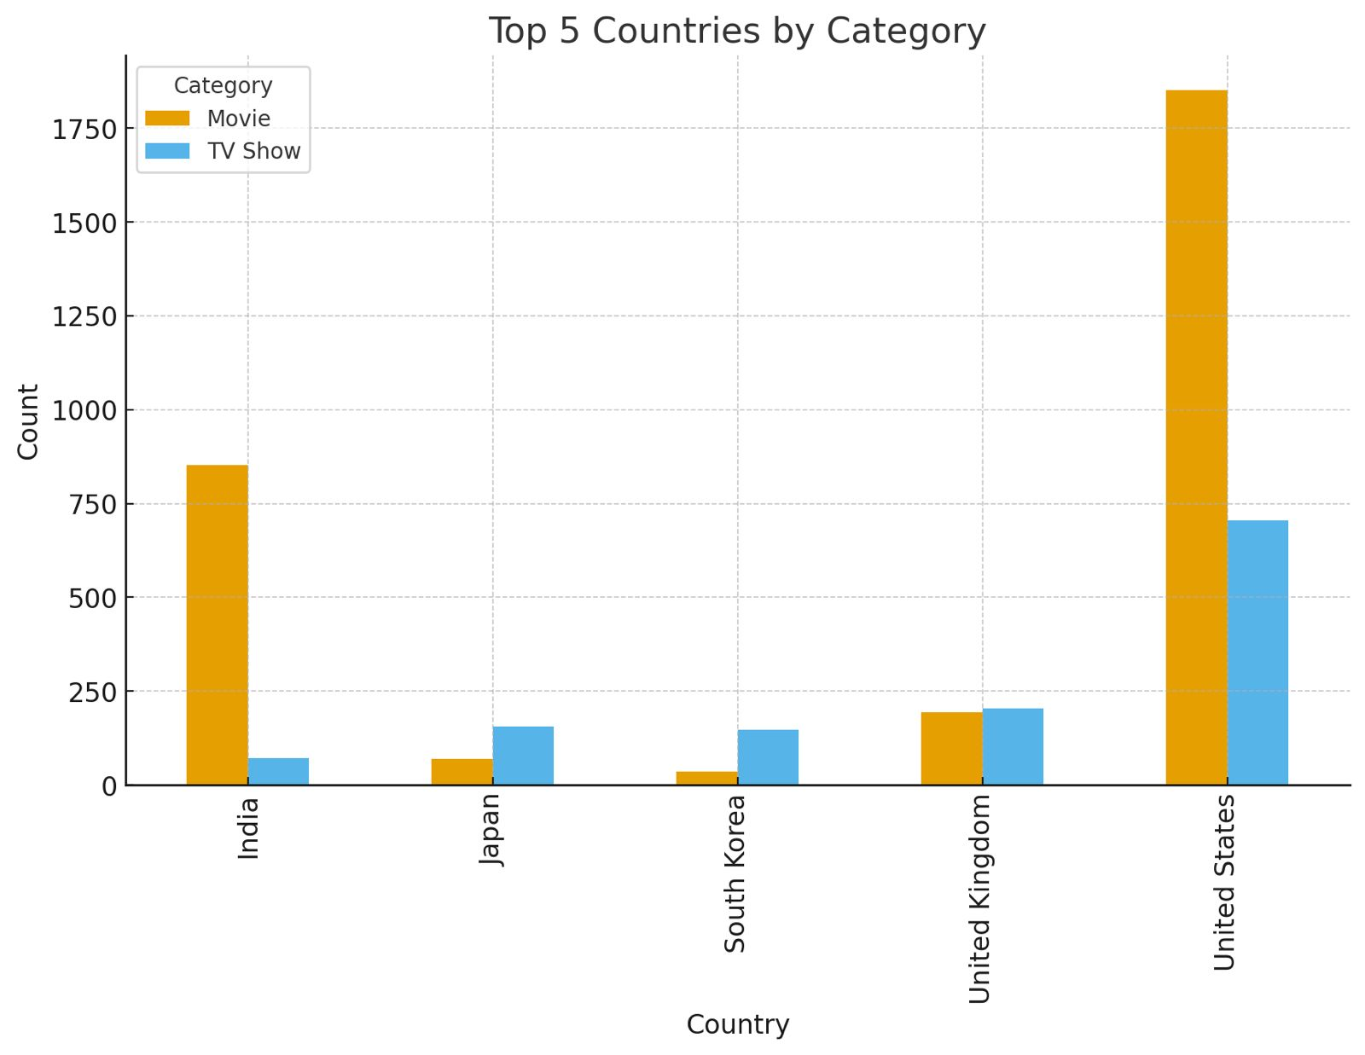
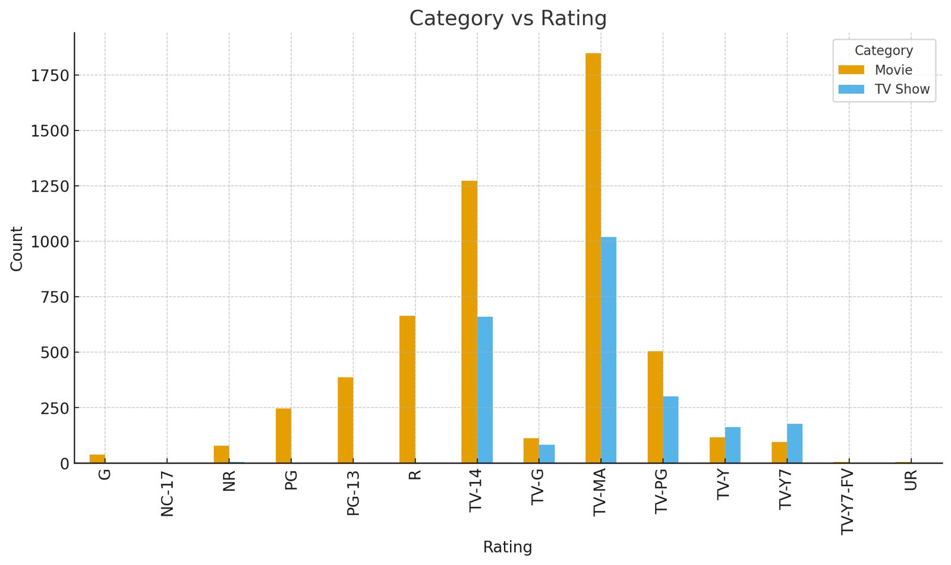
Visual Charts for Bivariate Insights
BAR CHART(CATEGORY VS RATING)
BAR CHART(TOP 5 COUNTRIES BY CATEGORY)

Slide 11
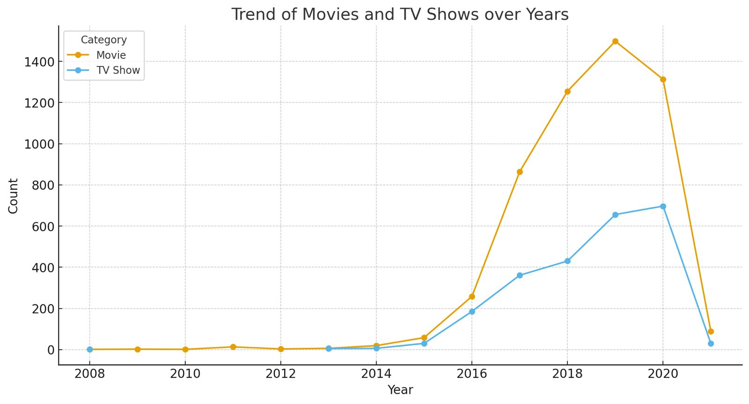
Visual Charts for Bivariate Insights
LINE CHART USED FOR TREND ANALYSIS OVER TIME

Slide 12
Conclusion
Yes, after handling missing values, removing duplicates, fixing inconsistencies, and applying data type corrections, the dataset is now clean and analysis-ready.
All key fields (Release_Date, Duration, Rating, Country) are standardized.
Text columns (Director, Cast, Description, Type) are consistent and usable.
No critical information was lost — missing data is handled with placeholders.
Ready for descriptive analysis, visualization, and predictive modeling.

Slide 13

THANK YOU

